Slide 1

Dam Removal and Local Impacts: Historic and Archaeological Resources
David Gould
Town Of Plymouth
Department Of Energy And Environment
February 7, 2024

Slide 2

Town Brook Restoration Program
Started in 2001
5 dam removals
1 nature-like fishway in progress
7 stormwater improvement projects in watershed
3 land acquisitions in watershed – one in progress
Trail improvements, park rehab projects and other amenities.
All work within the Town Brook Historic and Archaeological District

Slide 3

Town Brook Restoration Program and its Historical Context
All dams within the local historic district and within National Register District.
Most dams date to 1790’s and early 1800’s –Era of Industrialization
One dam dates back to 1636
Most dams are “considered” historic but what does that really mean? Varies by community and overall context.

Slide 4
Focus of Historic Resources
In the past focus has been predominantly on colonial era history
Limited attention paid to Native American History
Limited, if any, attention paid to natural history

Slide 5
Native History Considerations
Overall discussion and understanding of dam removals. Wampanoag tribe was/is supportive of the goals and reasoning behind these projects. Didn’t need to always explain everything which was welcome.
Aside from Section 106 we have included members in project review, plans, celebrations and interpretive displays.
Current nature-like fishway project: assisted in landscape design, planting plan and cultural awareness – wetu, shell paths, displays.

Slide 6
Natural History Considerations
Depends upon the community.
Town of Plymouth Holmes Dam Removal and PAL memo included natural history.
Recent letter from Town of Ipswich regarding Ipswich Mills Dam Removal. Thoughtful and well written letter that included all aspects of history.

Slide 7
Dam Removal and Historical/Archaeological Review
Regulatory Entities: Local Historic District Commissions, Massachusetts Historical Commission (SHPO), Native Tribes (Mashpee Wampanoag, Aquinnah Wampanoag and Narragansetts
Jargons and anacronyms: Section 106, APE, Contributing elements, Lead Federal Agency, MOA.

Slide 8

Section 106
Section 106 of the National Historic Preservation Act of 1966 (NHPA) requires federal agencies to consider the effects on historic properties of projects they carry out, assist, fund, permit, license, or approve throughout the country. If a federal or federally-assisted project has the potential to affect historic properties, a Section 106 review will take place.

Slide 9
Basic Terms
Section 106 of the National Historic Preservation Act of 1966 (NHPA) ensures that federal agencies take preservation values into consideration when they propose a project that may affect historic properties. In other words, it forces federal agencies to stop and look at the consequences their undertakings could have on historic (or potentially historic) places.
National Register of Historic Places - The five general categories for NRHP properties are: building, structure, object, site, and district.
Historic District is: "a geographically definable area, urban or rural, possessing a significant concentration, linkage, or continuity of sites, buildings, structures, or objects united by past events or aesthetically by plan or physical development. In addition, historic districts consist of contributing and non-contributing properties.
Area of Potential Effect (APE) "The geographic area or areas within which an undertaking may directly or indirectly cause changes in the character or use of historic properties, if any such properties exist.
Contributing Elements -16*

Slide 10
Common Steps
Desktop Survey
Archival Photo-documentation
Archaeological Data Recovery Field Work
Fieldwork Completion Memorandum
Archaeological Mitigation Technical Report

Slide 11
Lead Federal Agency
When an undertaking subject to review under Section 106 of the National Historic Preservation Act is carried out, licensed, permitted, approved, or assisted by more than one federal agency, the Section 106 regulations allow for some or all of those agencies to designate one lead federal agency. The lead federal agency shall identify the appropriate official to serve as the agency official who shall act on their behalf, fulfilling their collective responsibilities under section 106¹².
Can be a permitting entity or major funding entity. Will sign the MOA along with other parties.
Ex. NOAA, USACE, USFWS

Slide 12
Permitting Challenges
Ecological goals v. historic and archaeological concerns
Example: Brewster Gardens stone walls along Town Brook. Some agencies wanted the walls protected and/or reconstructed while other (environmental) agencies wanted them removed for ecological reasons.
Solution=Compromise: Most of the walls reconstructed but kept dry laid stone. Remainder removed and allowed to connect to floodplain and return to wetland state.

Slide 13

Memorandum of Agreement
Under the Federal regulations governing compliance with Section 106 of the National Historic Preservation Act, Federal agencies and others negotiate, draft, finalize, execute, and implement "Memoranda of Agreement" (MOA) stipulating how the adverse effects of Federal actions on historic properties will be resolved¹. The MOA is a legally binding document that evidences the agency’s compliance with Section 106 and records the outcome of consultation and the effects of an agency’s project, projects or program on historic resources²³.
Parties – Ex. Lead Federal Agency, MHC and Town.

Slide 14
Moving Forward
Photographic documentation of resources
Oversight during work within “sensitive” areas
Artifacts to SHPO
Desktop survey and additional reports are new resources for the community
Off Billington Street Dam Removal – first municipal water main found – now what?

Slide 15

Avoidance and Mitigation
If impacts can not be avoided or minimized there may be a requirement to mitigate
Example: Brass plaques, Interpretive displays, documenting and leaving resources intact but buried in place.
  Creative approaches: Re-use of materials, display of materials, emphasizing natural history in addition to man-made history.

Slide 16
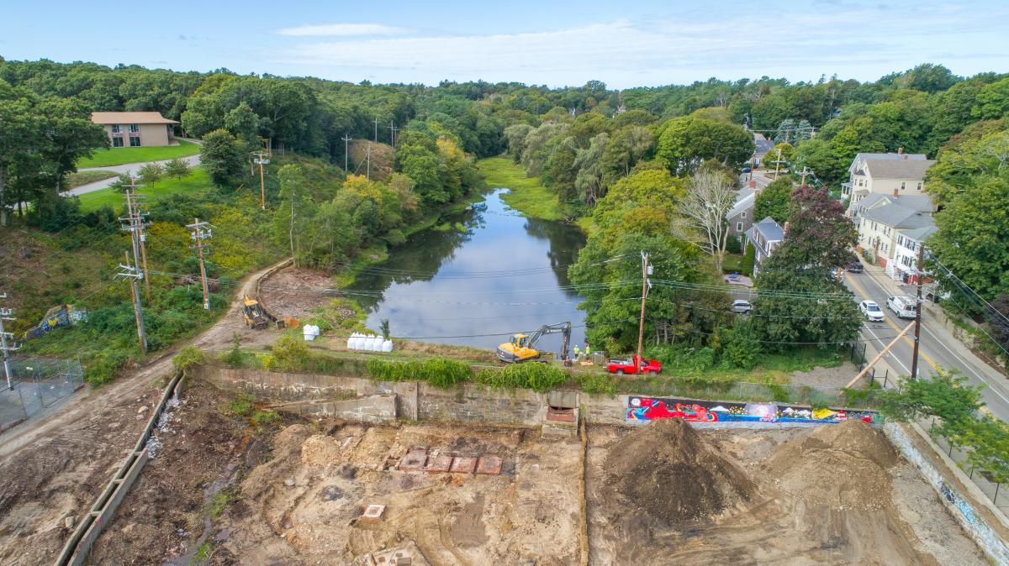

Slide 18
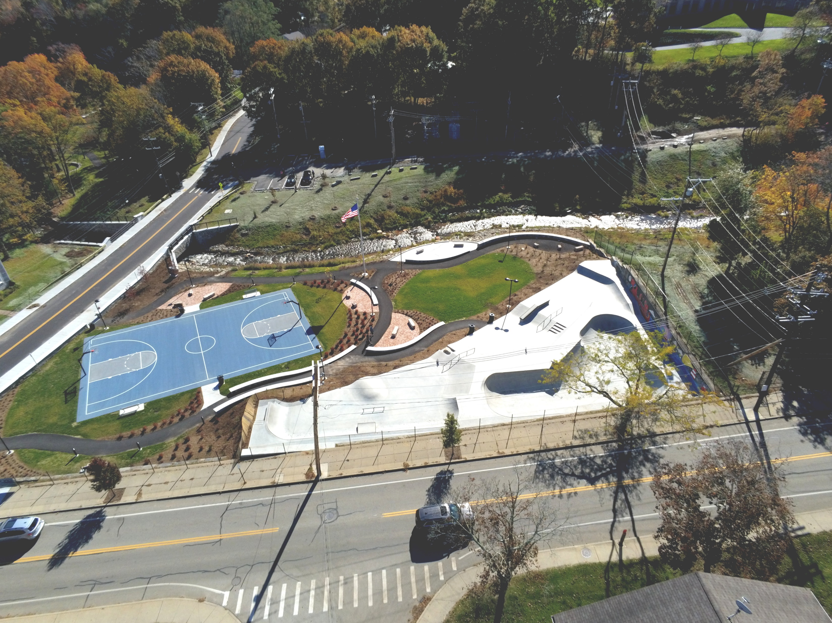

Slide 19
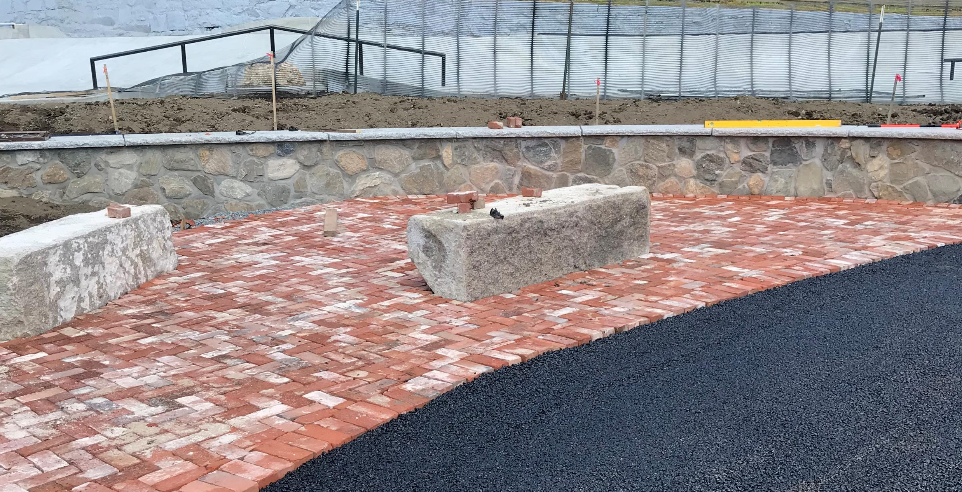

Slide 20
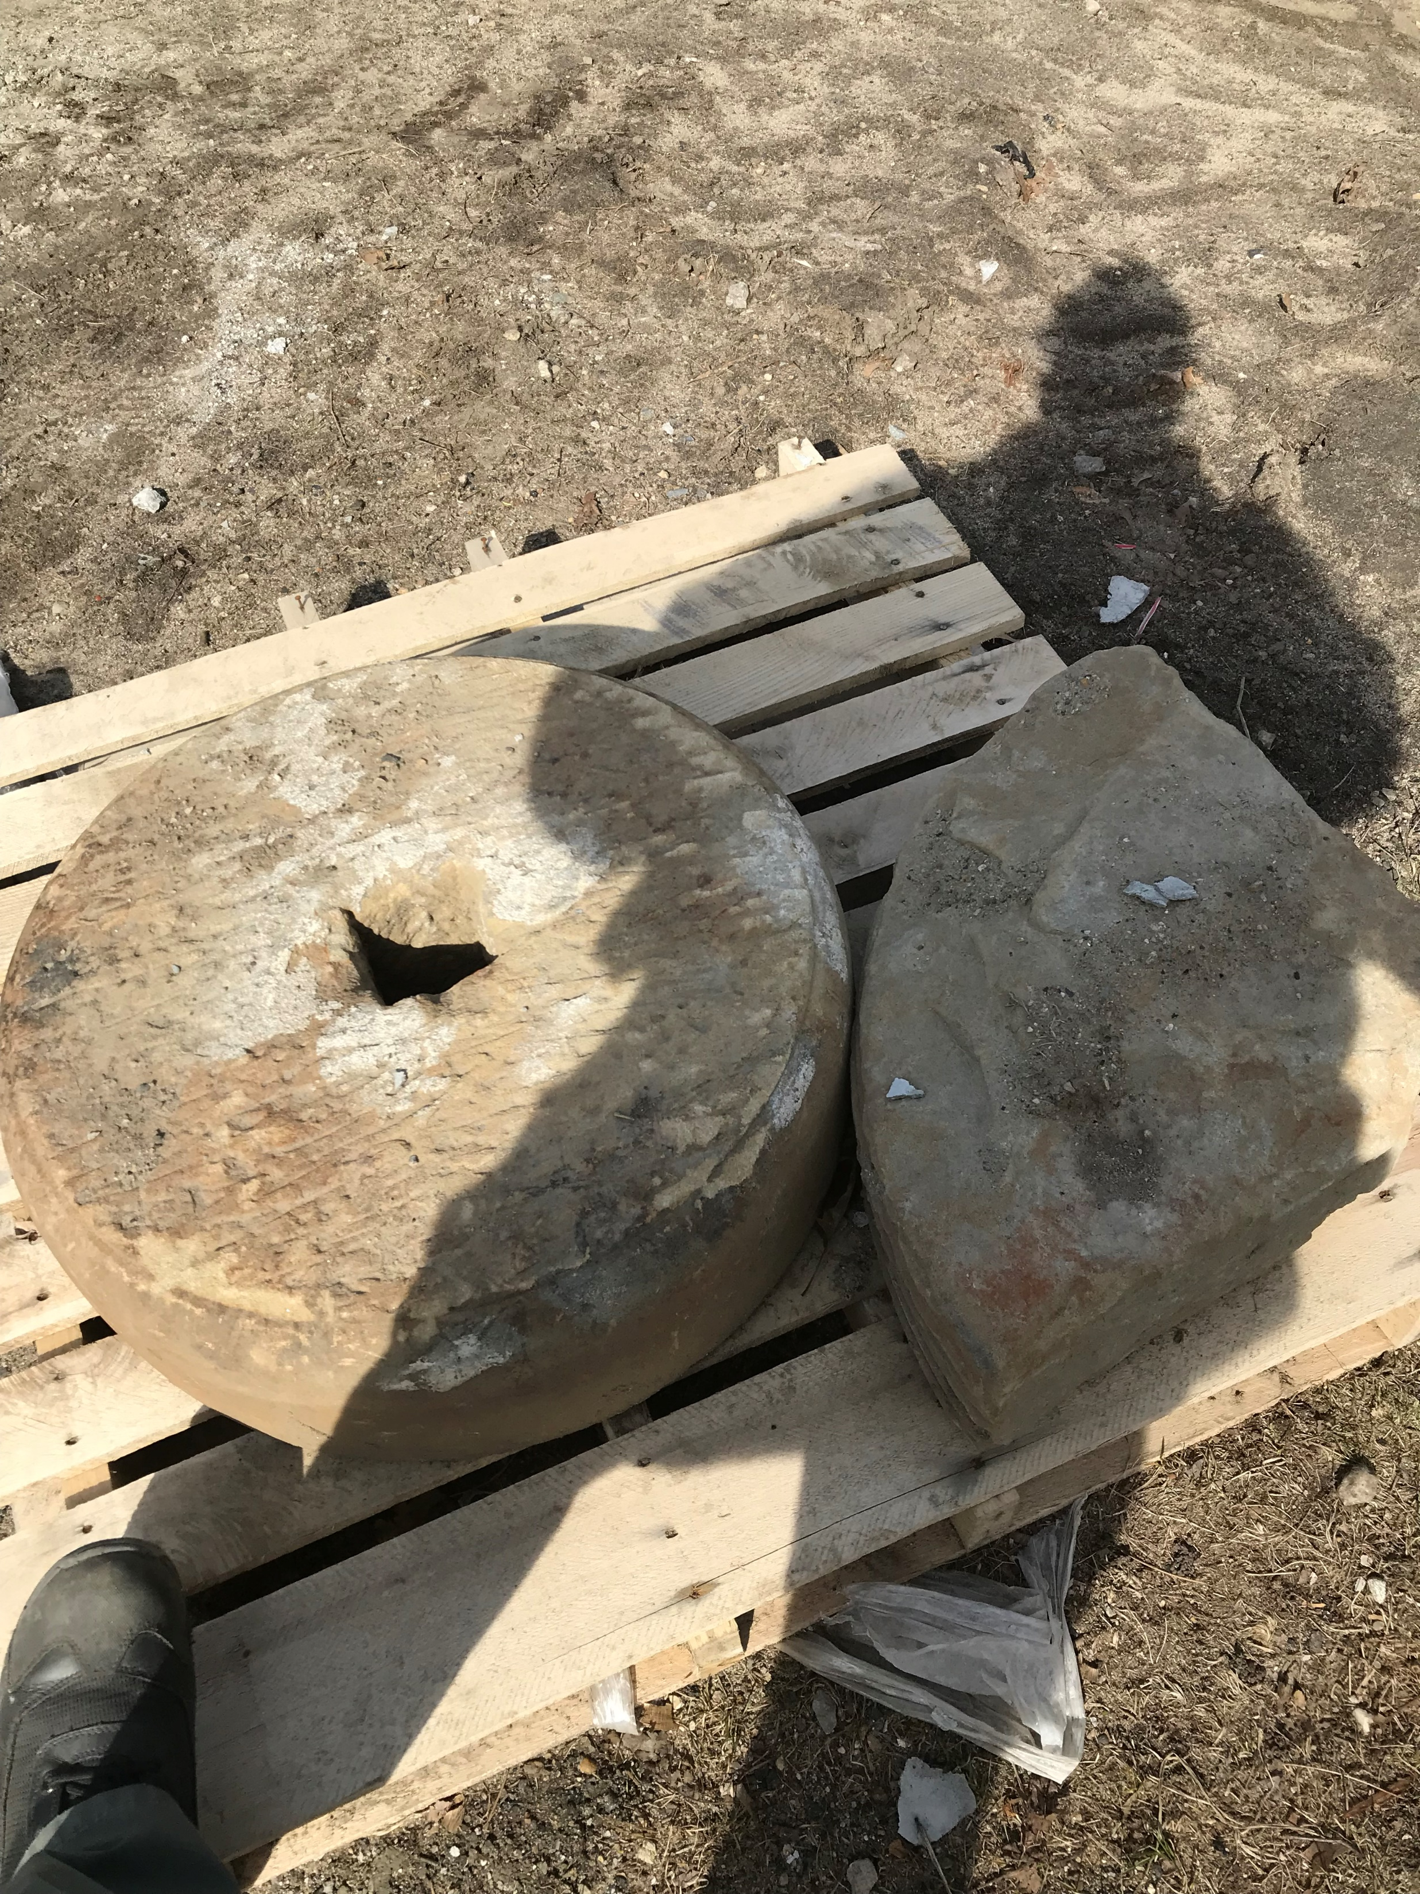

Slide 21
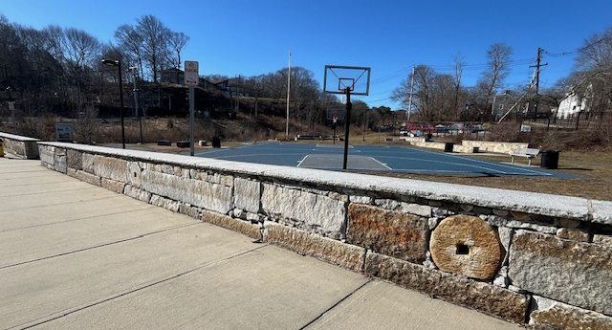

Slide 22
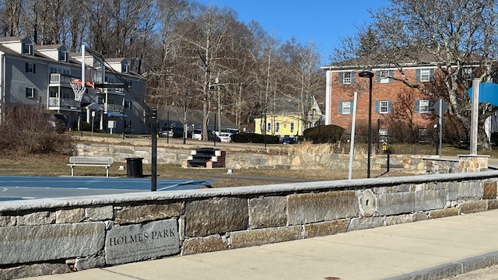

Slide 23
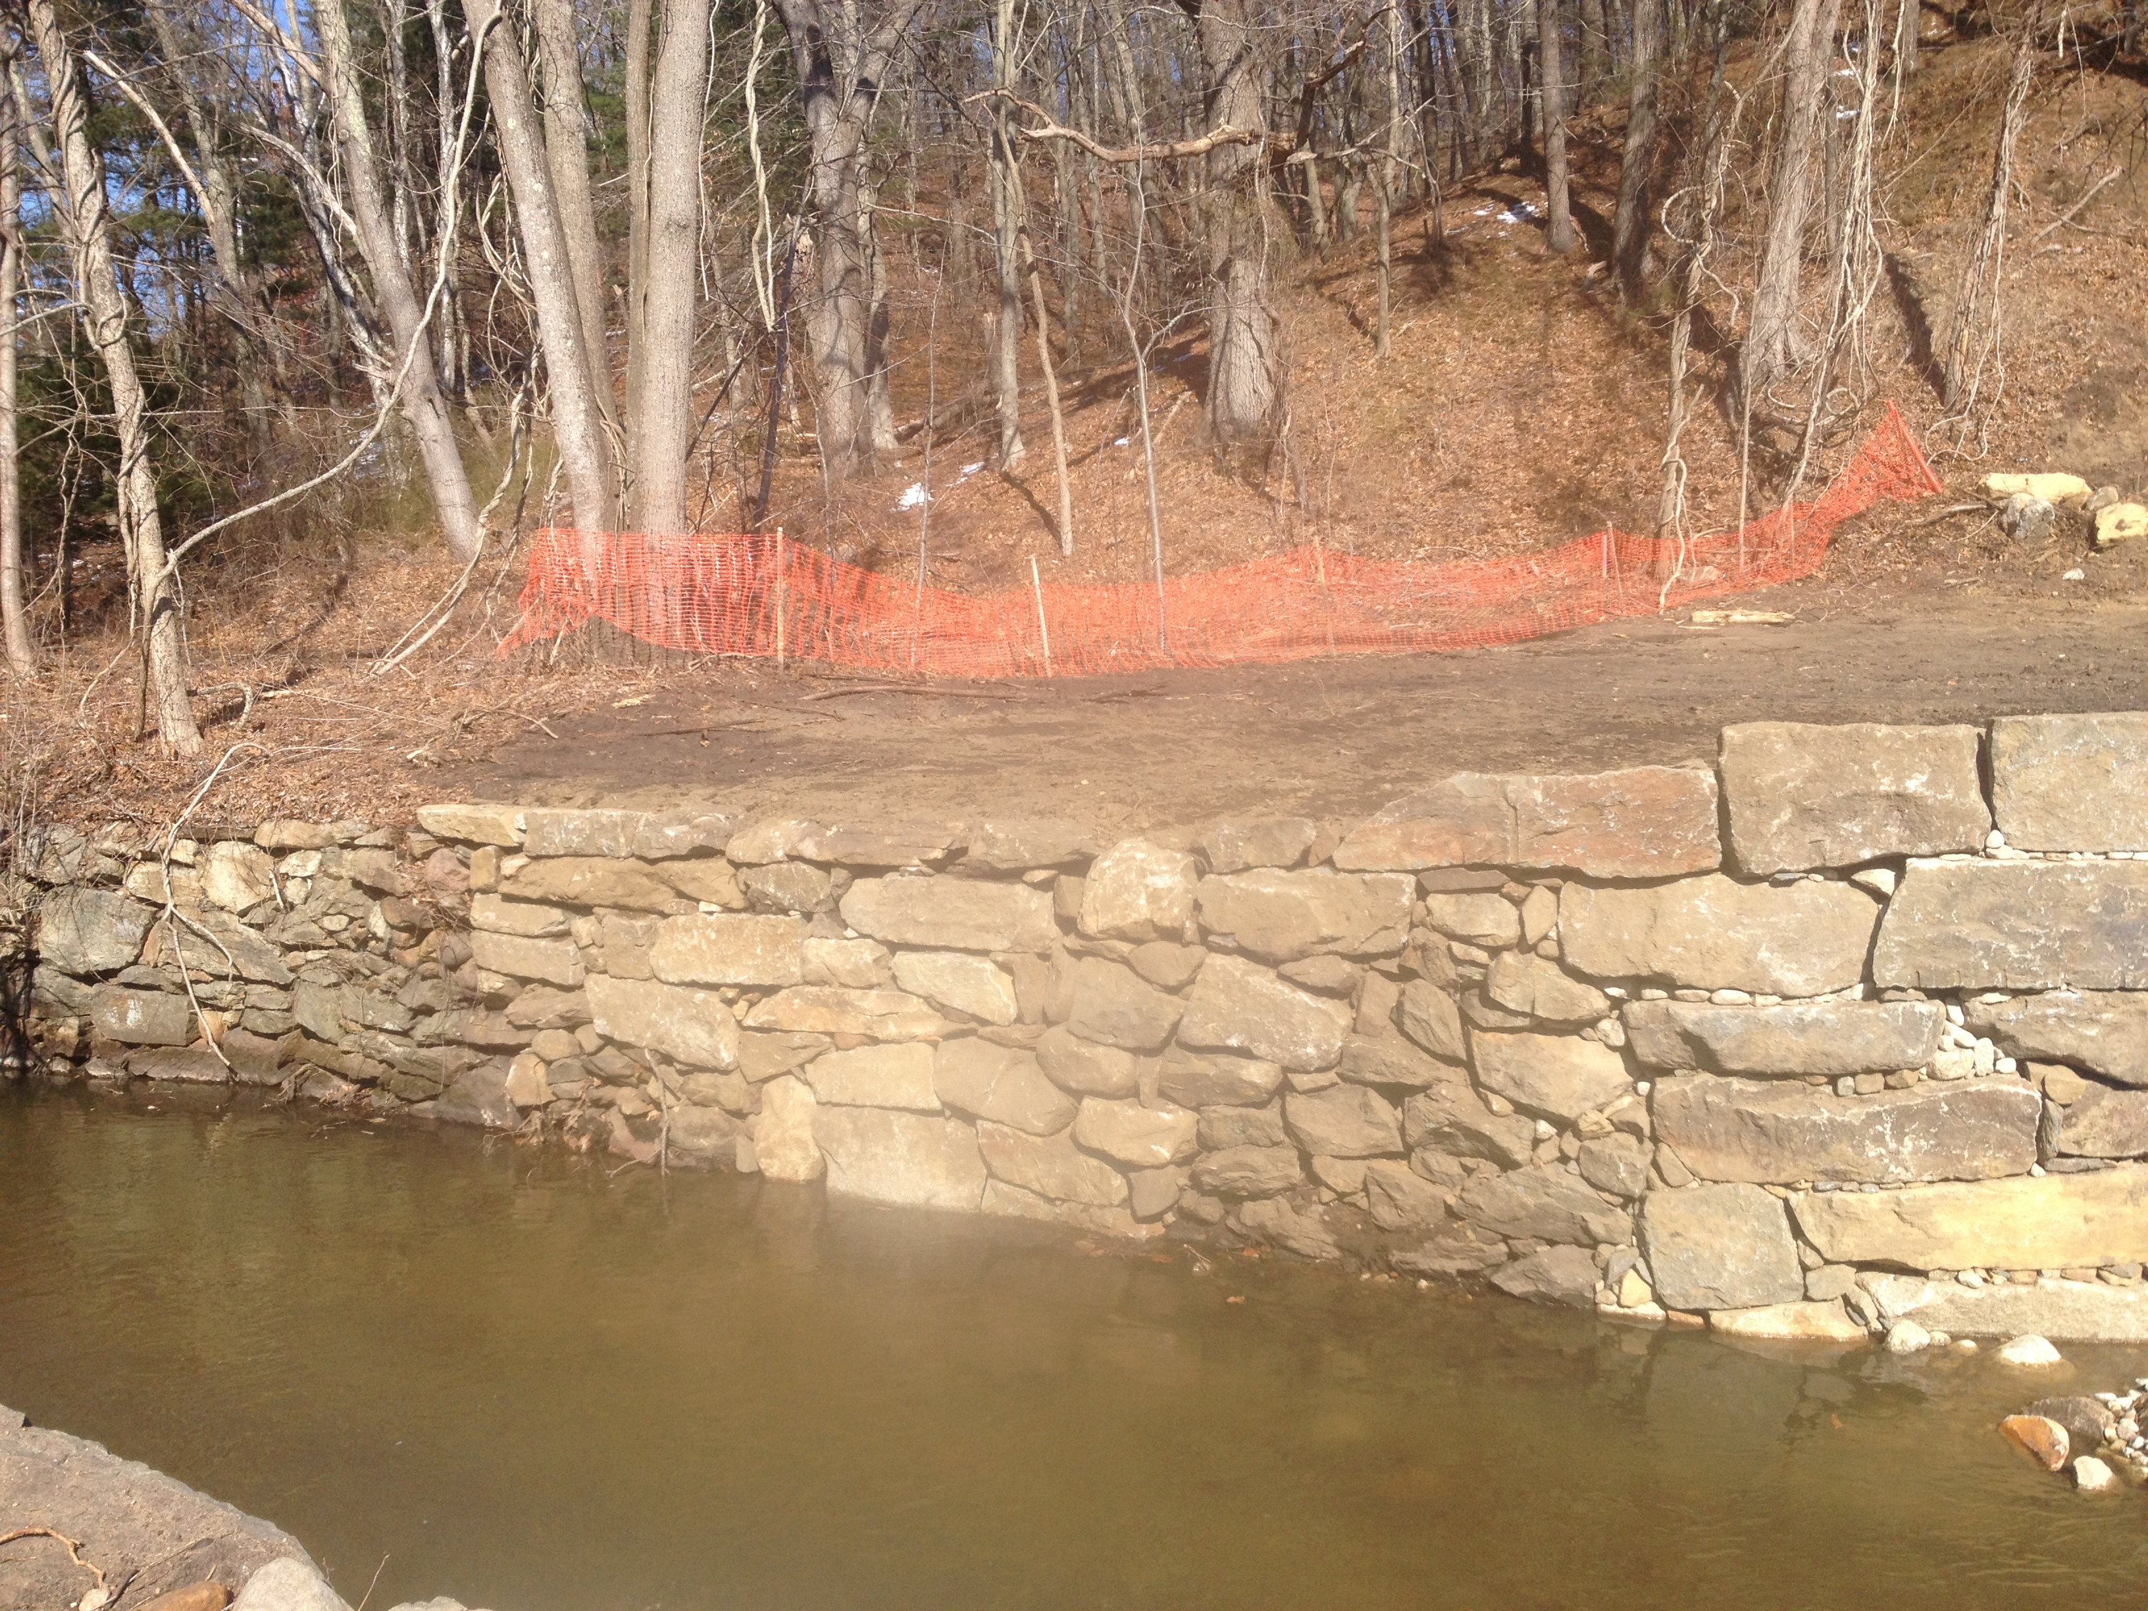

Slide 24
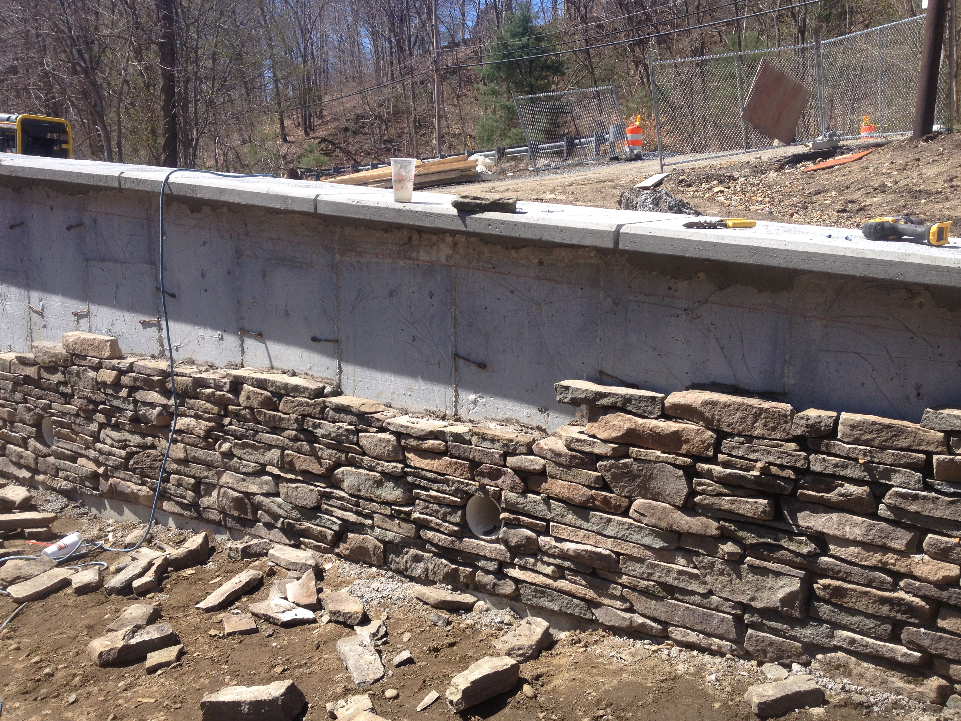

Slide 25
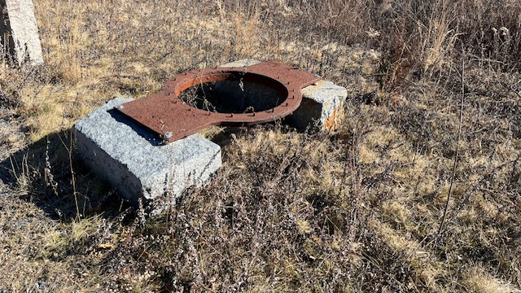

Slide 26
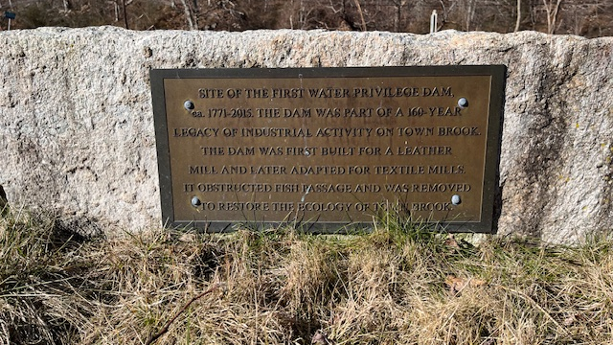

Slide 27
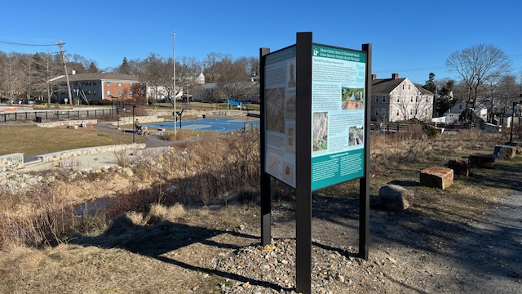

Slide 28

Thank You
The nation behaves well if it treats natural resources as assets, it must turn over to the next generation increased, not impaired, in value”
-Theodore Roosevelt (1910)
David Gould, Director
Department of Energy and Environment
508-747-1620 x 10134
dgould@plymouth-ma.gov

