Slide 1
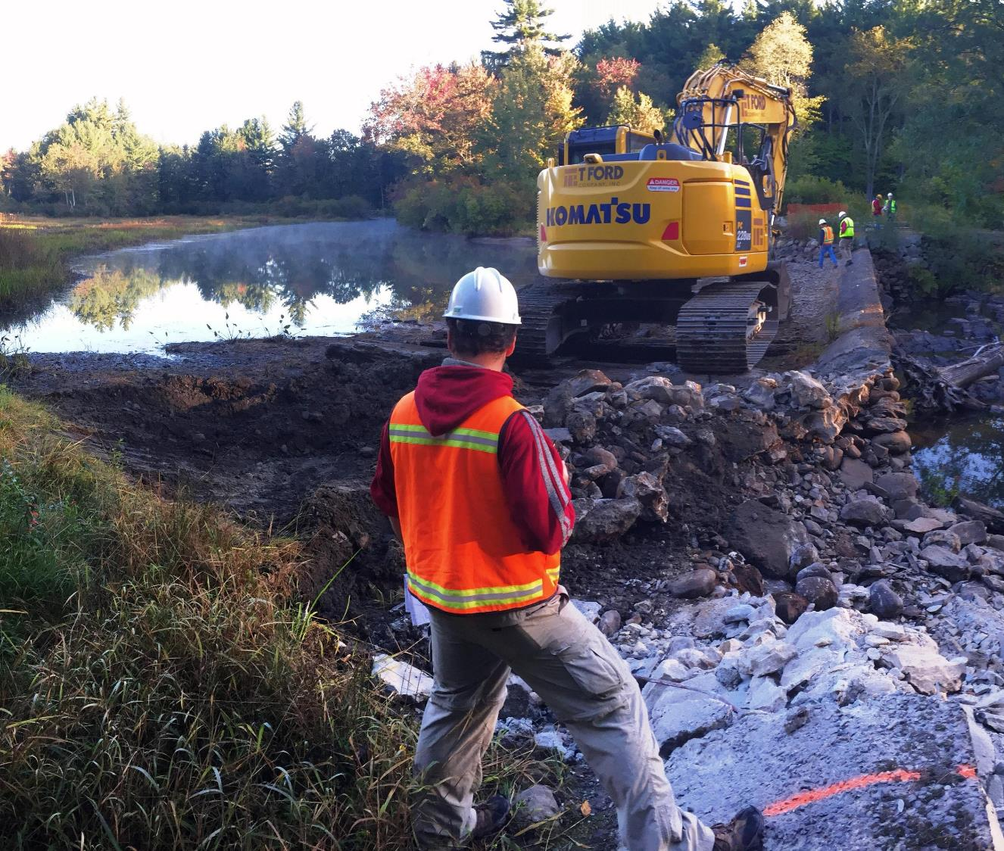

The Dam Removal Process and
The Role of the Project Manager
Dam Busters 101
November 1, 2023

Slide 2
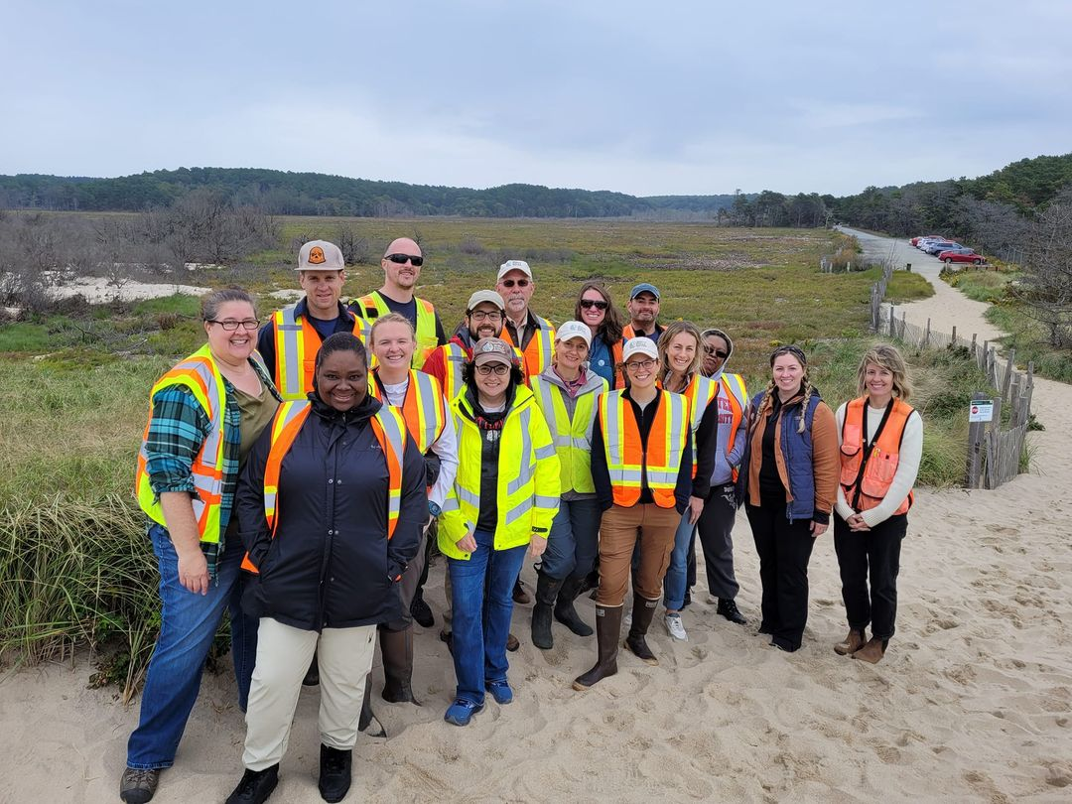
Massachusetts Division of Ecological Restoration (DER)
State agency, part of Dept. of Fish and Game
27 staff
4-person dam removal program
Also coastal wetland restoration, freshwater wetland restoration, culvert upgrade grants…
Presentation is based on our experiences

Slide 3
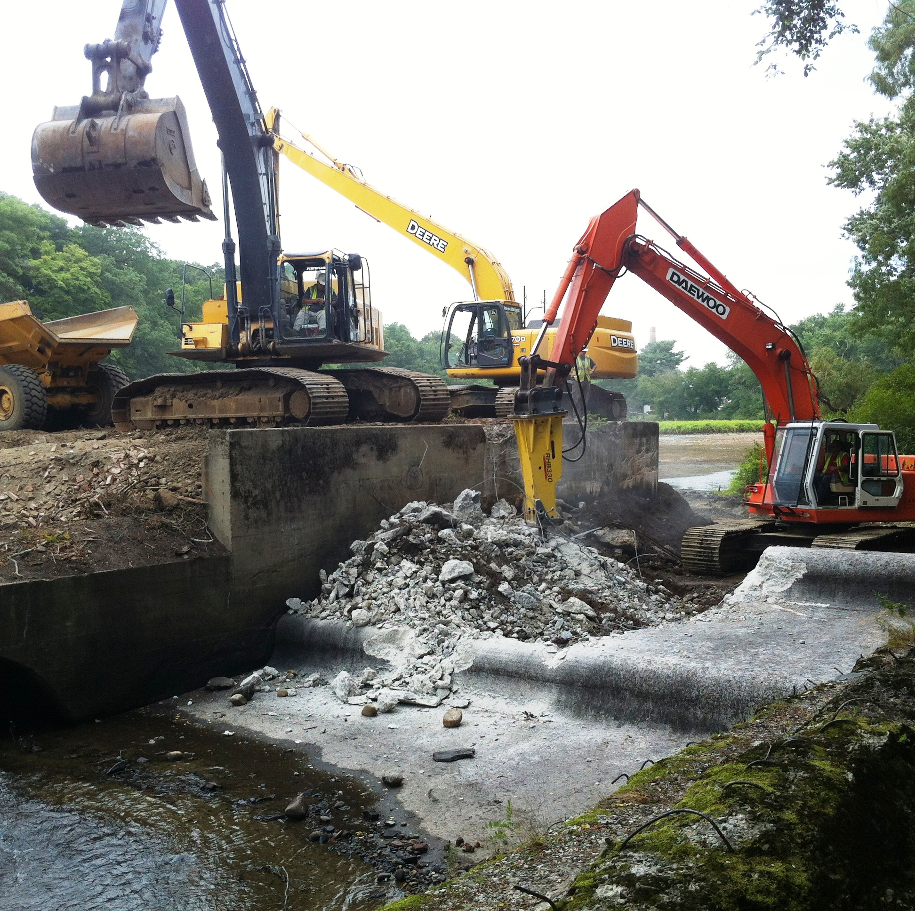
The Dam Removal Process and the Role of the Project Manager
Hopewell Mills Dam Removal,
Mill River, Taunton, 2012
1. The role of the project manager
2. Overview of the dam removal process
3. Discussion
Audience:
Municipal or non-profit organization staff that are planning to manage a dam removal project

Slide 4
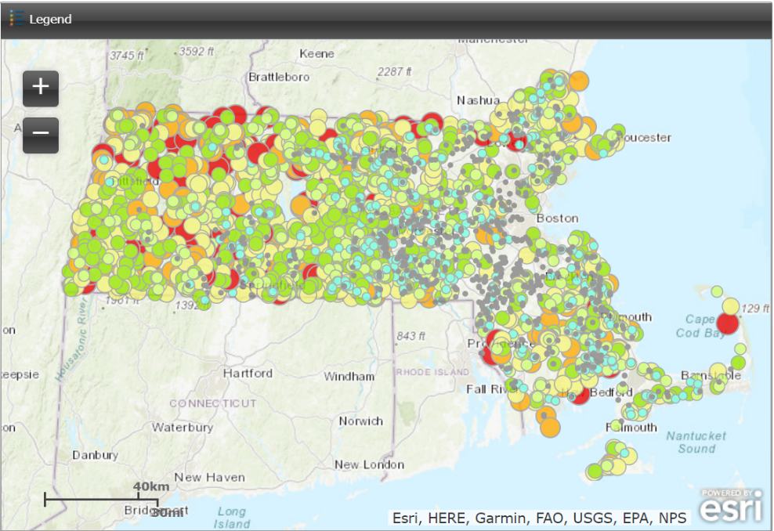
Massachusetts has more than 3000 dams
Owned by towns, private companies, individuals, NGOs, the state…
Small % provide drinking water, flood control, regional recreation
Most built to power mills in the 1700s-1800s
~70 removed in last 15 years

Slide 5
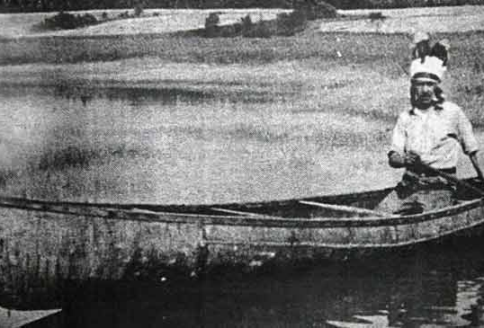
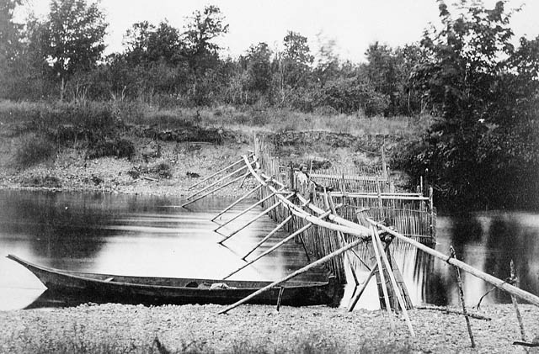

Slide 6
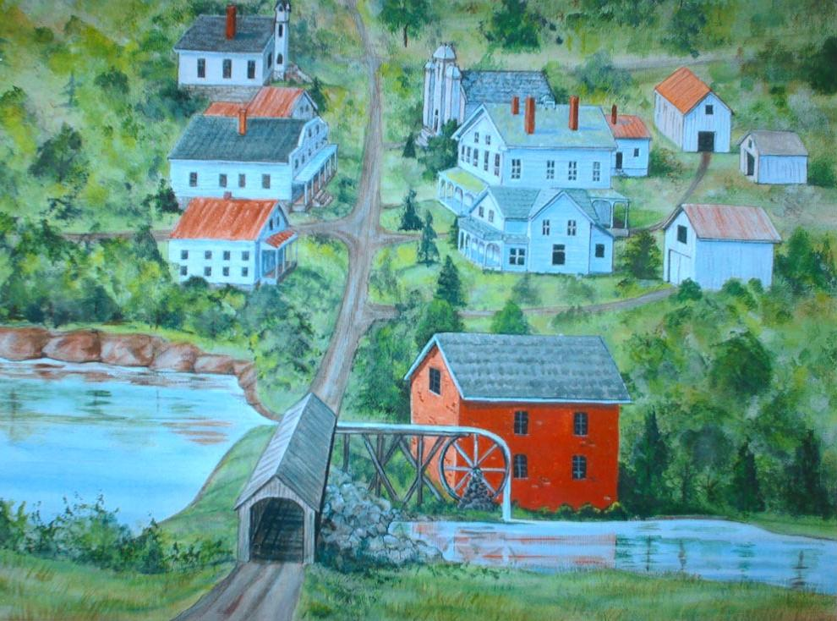
Notes:
An overwhelming majority were built a LONG time ago for purposes like this...

Slide 7
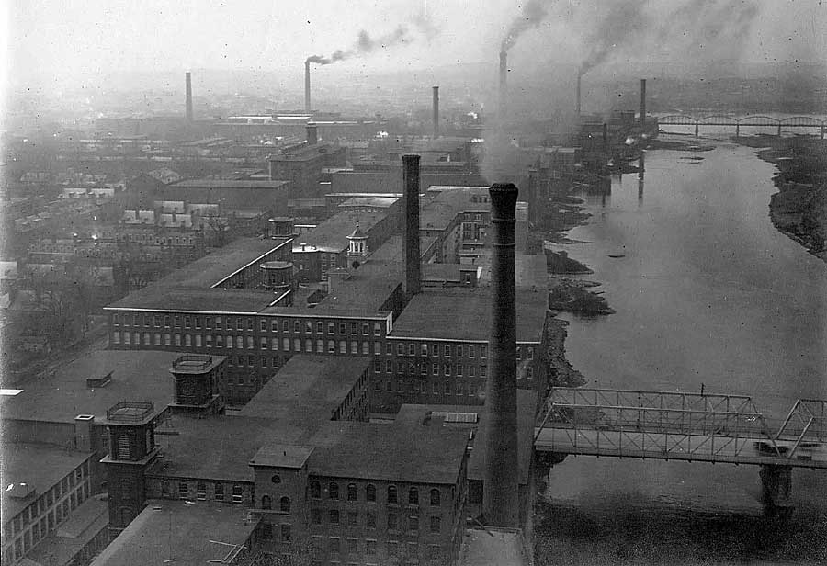
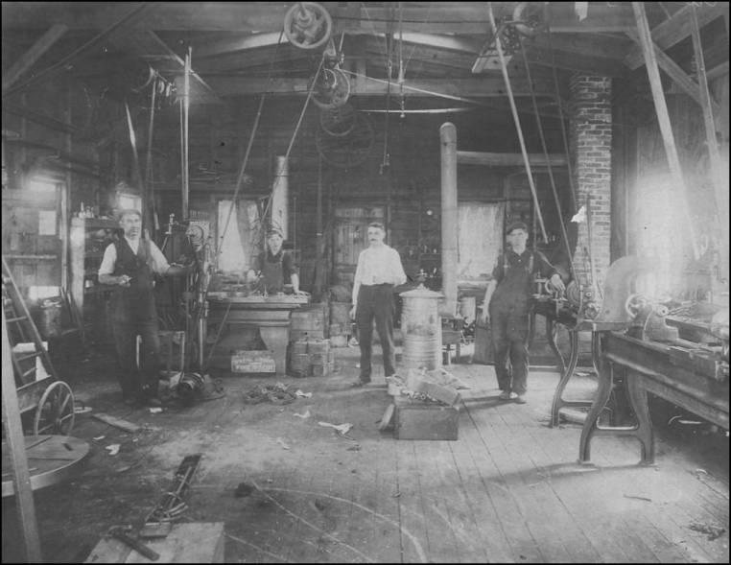
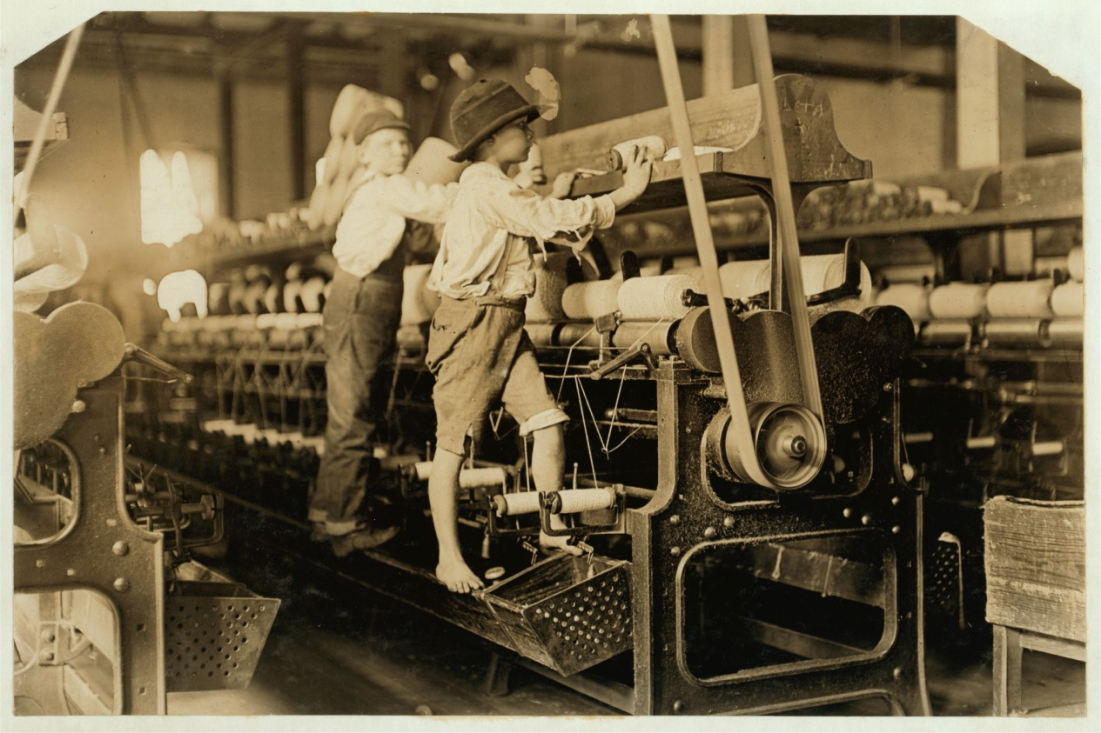
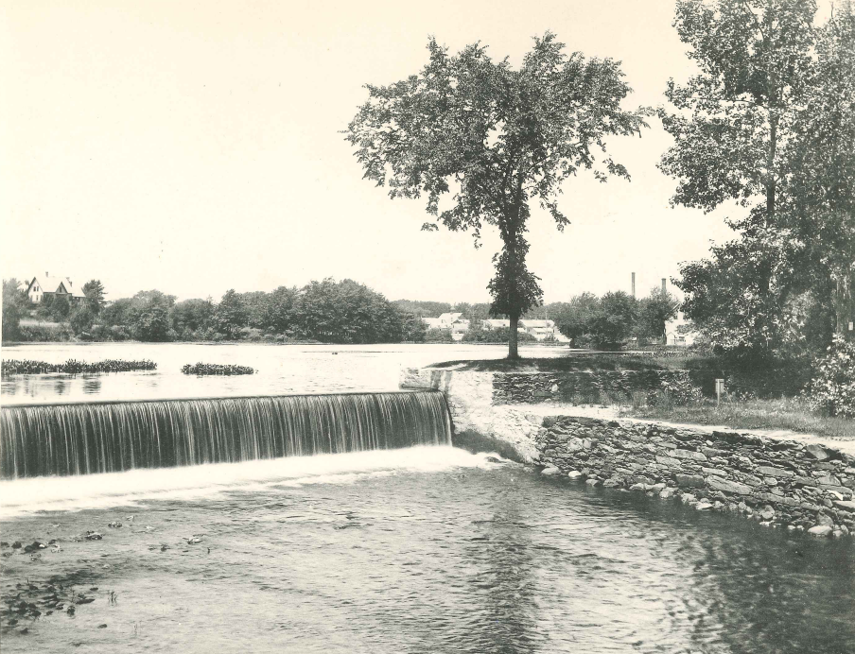

Slide 8
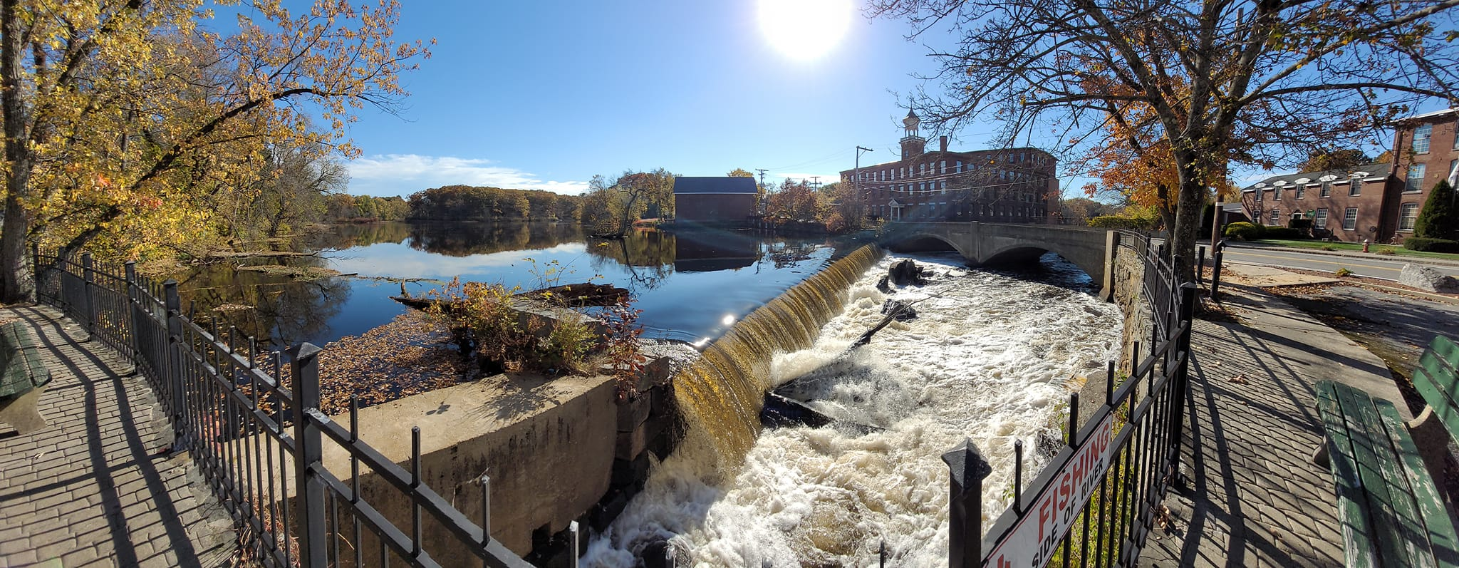
Billerica Dam / Talbot Mills Dam, Concord River
The Oldest Dams Were Controversial When Built

Slide 9
Timeline
Billerica Dam, Concord River
1710 – dam constructed
1711 – first lawsuit
1722 – dam removed – rebuilt – removed by force – rebuilt
1723 – agreement to open spillway for two months for fish migration
1798 – lawsuit
1828 – dam built higher
1860 – lawsuit
2000s – consideration for fish passage or removal
2023 – moving towards removal
“Mere shad, armed only with innocence and a just cause…I for one am with thee, and who knows what may avail a crowbar against that Billerica Dam?”
-- Henry David Thoreau, 1839
“For generations, a painful and expensive controversy has existed in relation to the [Billerica Dam, and if not removed now, the children, and children’s children of these parties will be cursed with strife and contention”
-- Henry French speaks to the Massachusetts legislature in 1861

Slide 10
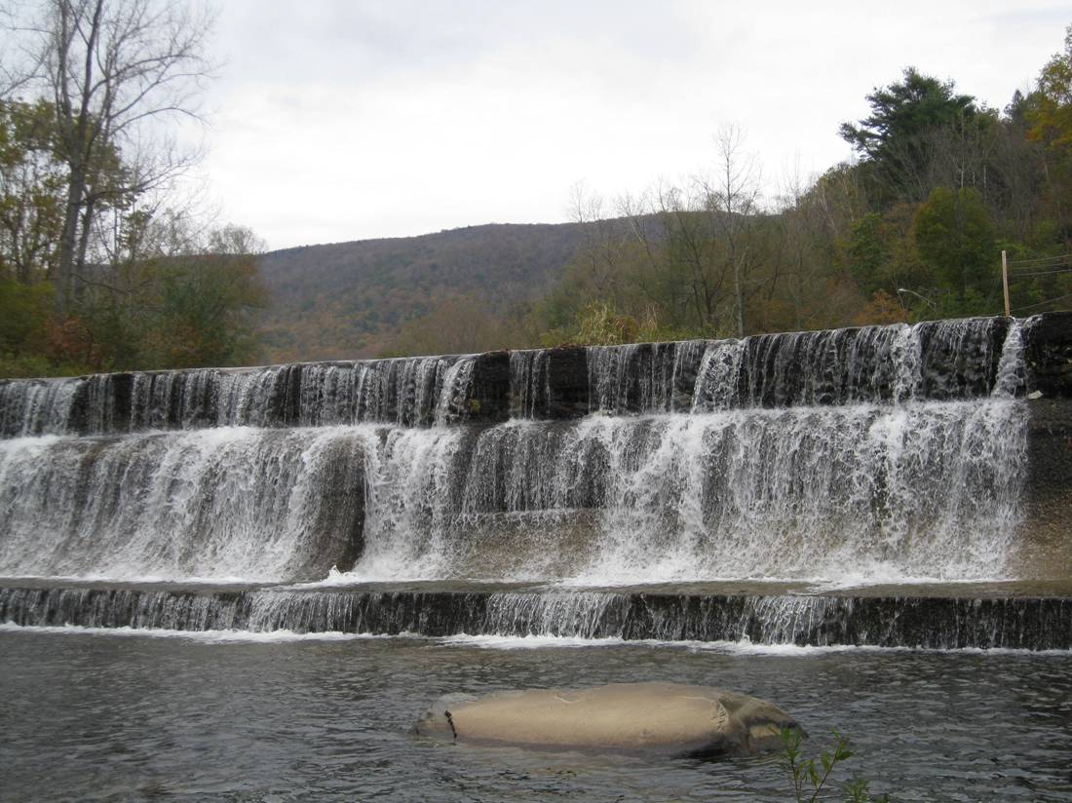
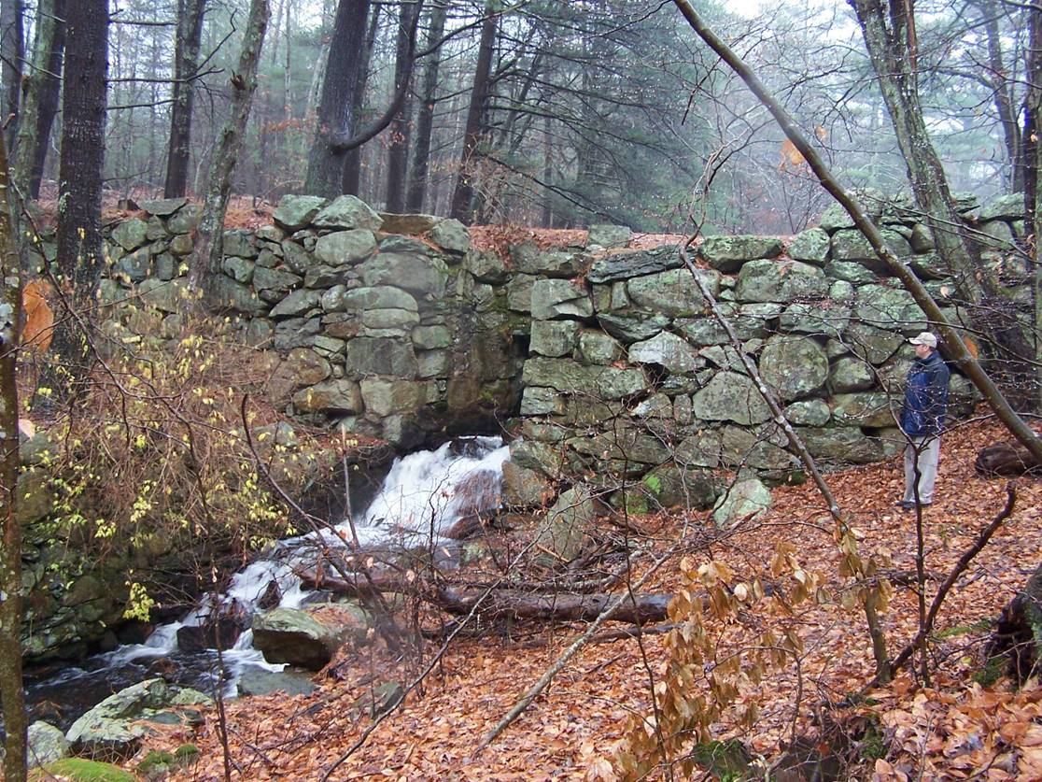
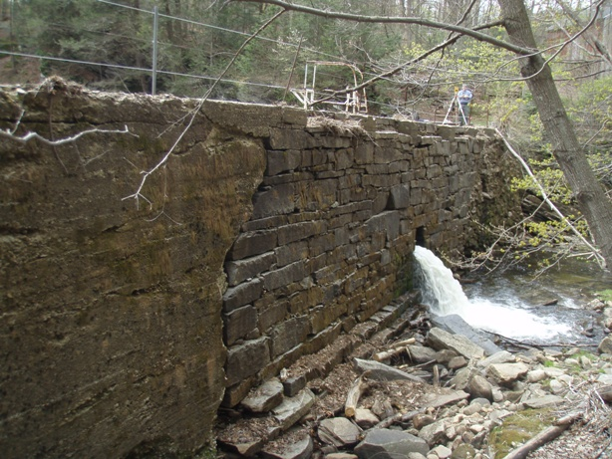
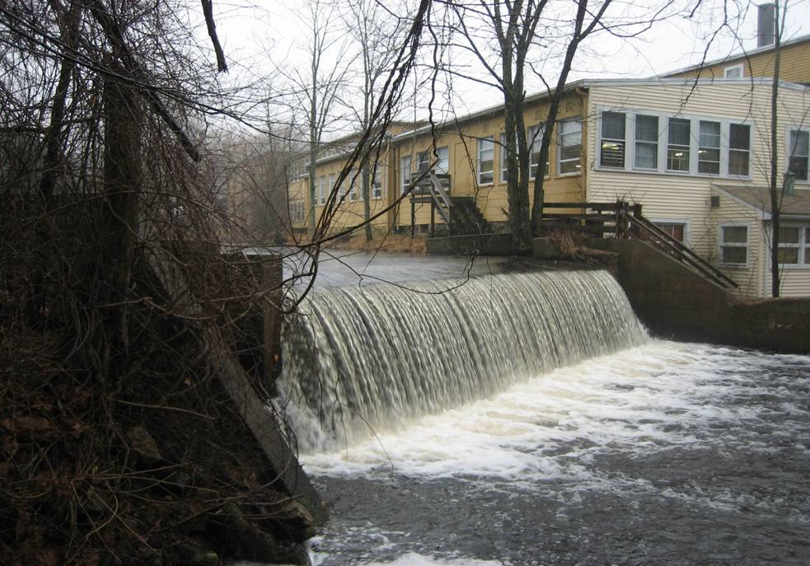
20th Century: Dam Abandonment
Most dams in MA were originally built to power mills.

Slide 11
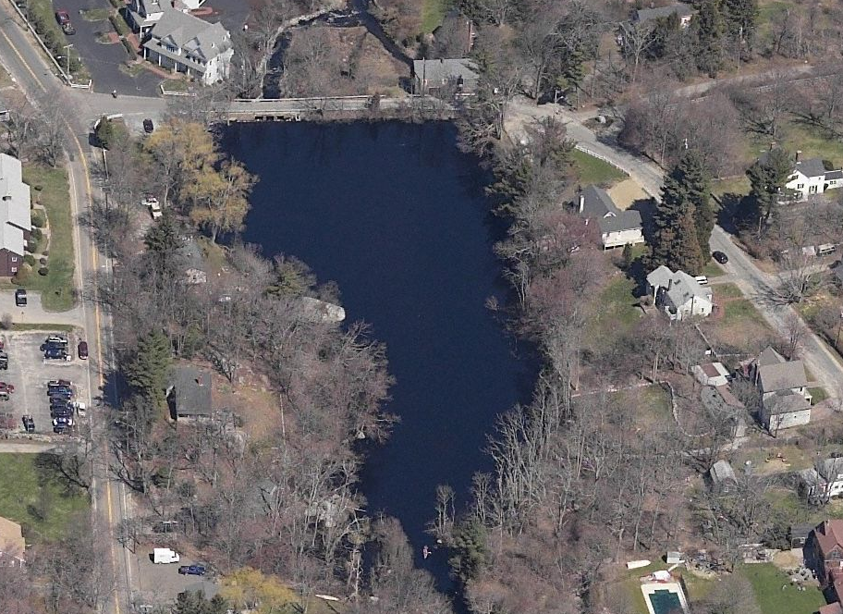
2. Others enjoy benefits of the dam
Common Functions of Dams Today
Road / utility corridor
Owns a kayak
Loves the view
Waters lawn
Watches birds

Slide 12
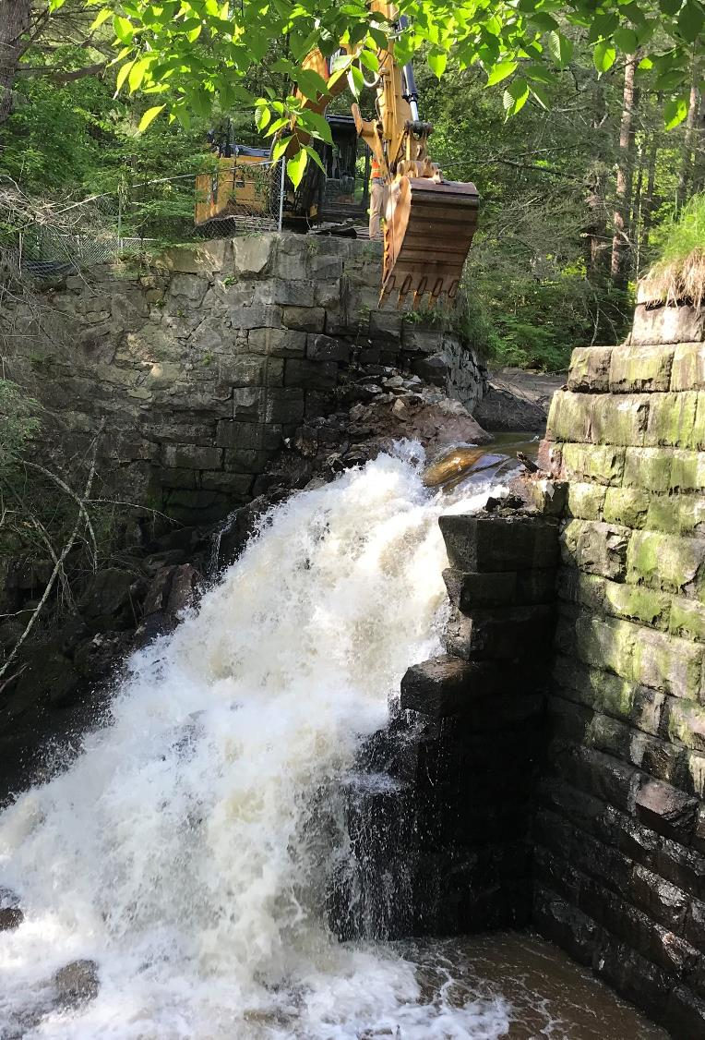
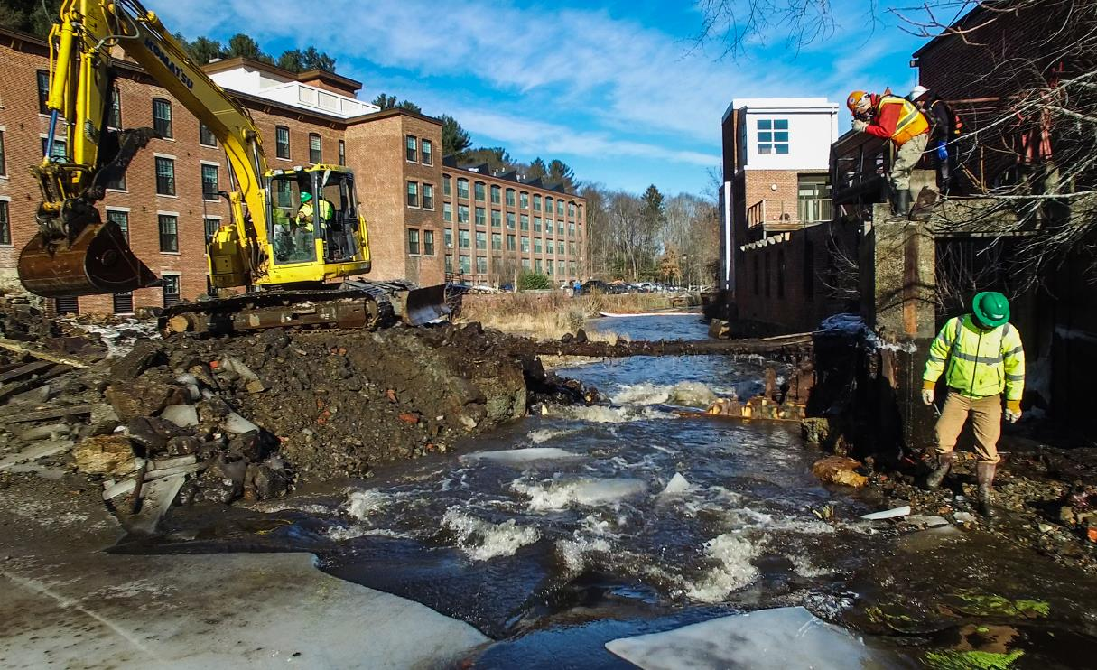
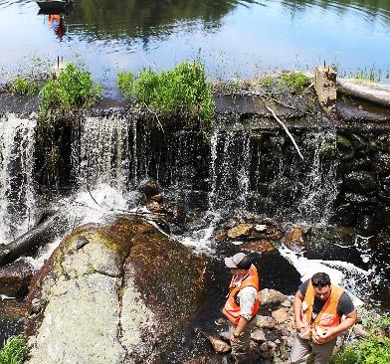
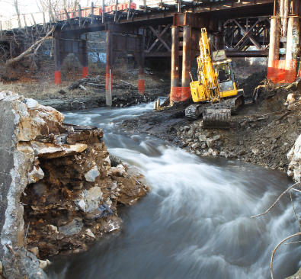
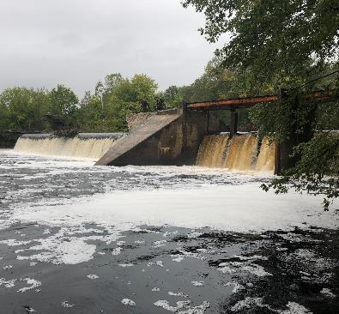
21st Century: Dam Removal

Slide 13
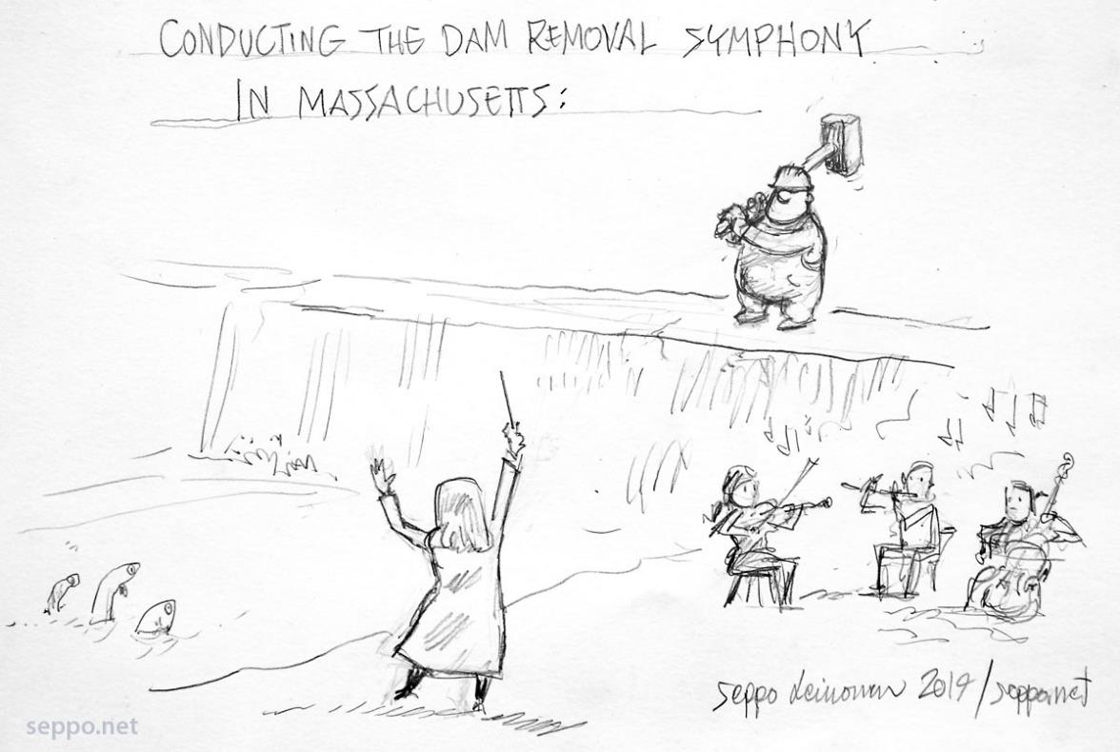
The role of the dam removal project manager: Part 1

Slide 14
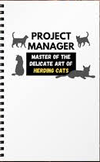
The Role of the Dam Removal Project Manager

Slide 15
The project manager should…
Provide leadership
Coordinate tasks described in this training
Delegate to project partners (if applicable) and consultants
Serve as point of contact
Track progress
Call on experts
Build partnerships
Maintain sense of humor!

Slide 16
The Process
1. Dam owner wants to remove dam
2. Project Scoping
3. Cost / feasibility assessment
4. Engineering & Design Process
5. Fundraising
4. Permitting
Final Construction Plans and Permits
Bid Process / Contracting
Dam Removal!!!

Slide 17
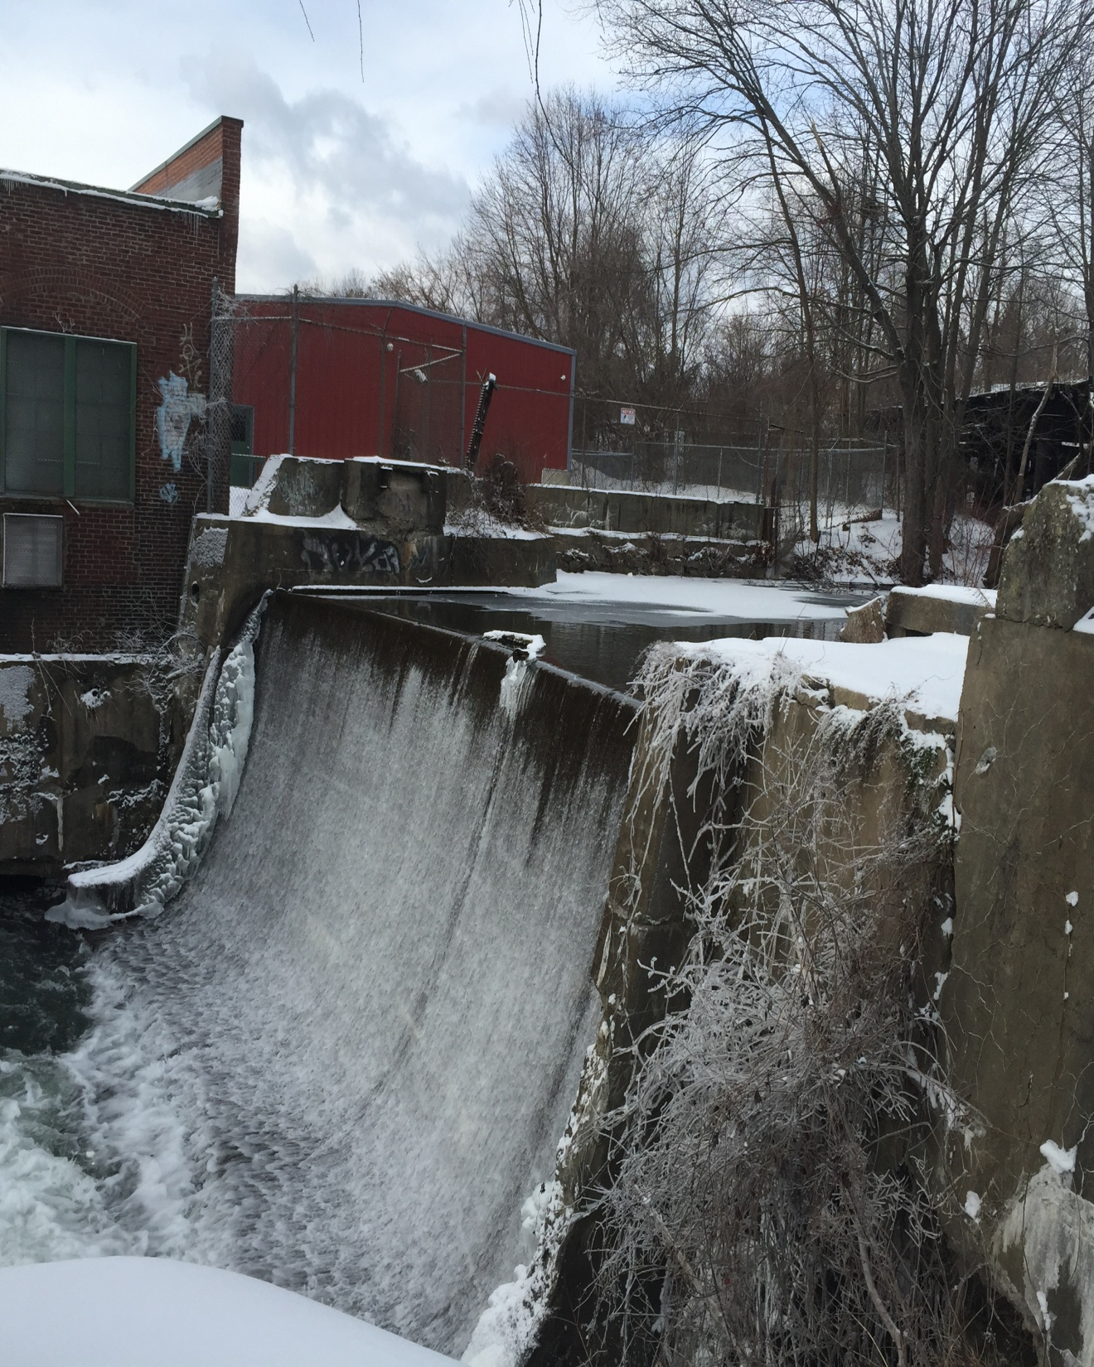
Project Scoping – led by Project Manager
Mill Street Dam, Pittsfield
Ownership of dam
Infrastructure (utilities, buildings, roads, walls)
Likelihood of sediment contamination
Other uses of impoundment
Traditional Knowledge of River
Habitat benefit (of dam; of removal)
Potential recreation benefits of removal
Notes:
Private or municipal dam owners can do a dam removal themselves and streamline the process. If the project is a proactive, partnership based restoration project, then there are fundraising and community outreach throughout the process. Fundraising takes time.

Slide 18
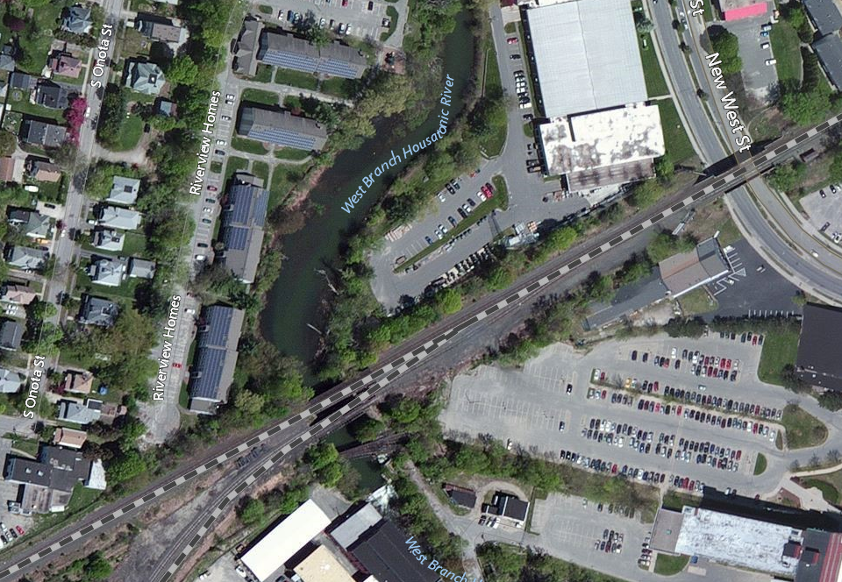
Mill Street Dam, Pittsfield

Slide 19
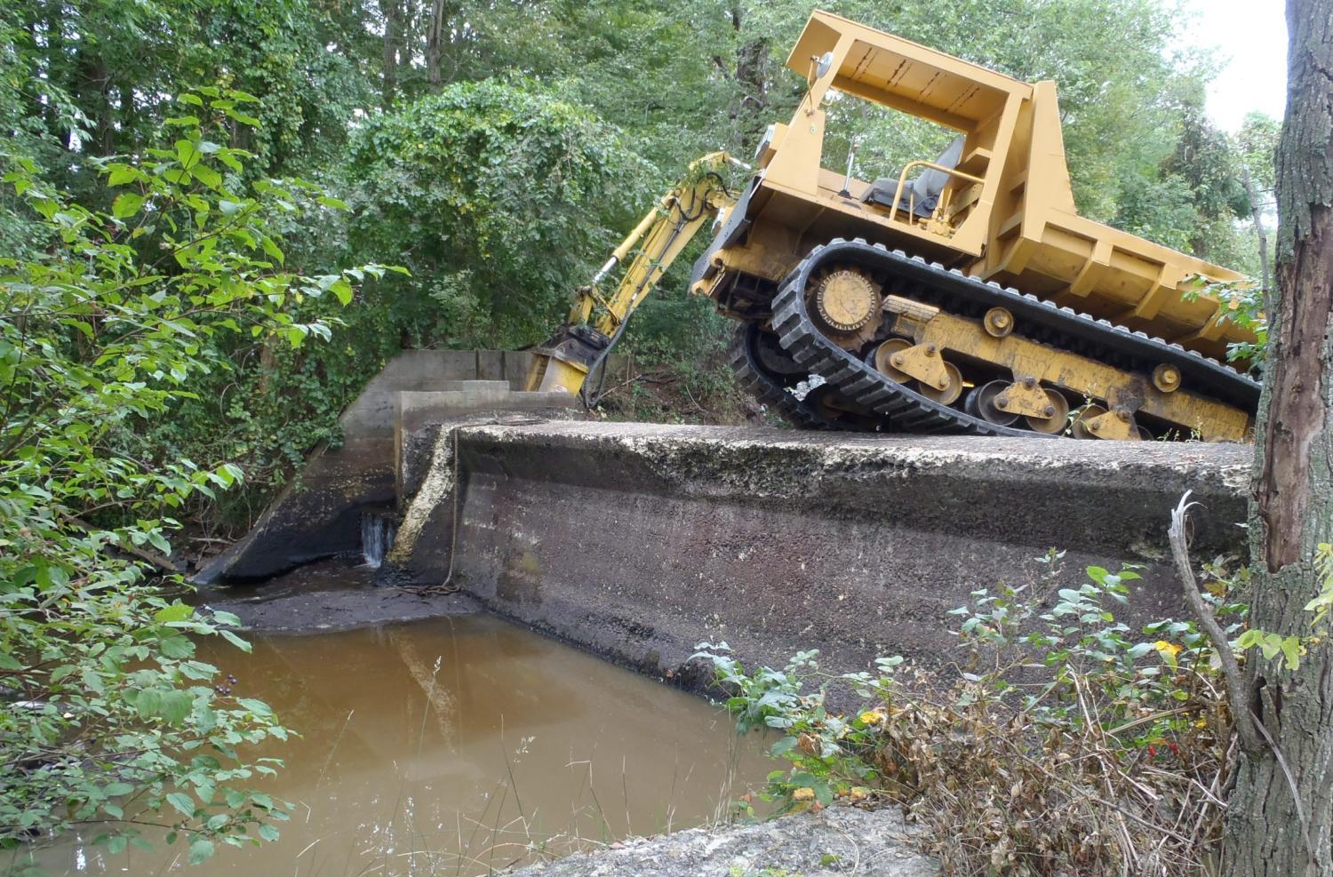
3. Cost / Feasibility Assessment
Should be based on project scoping
Target key issues of concern
May incorporate community concerns
Notes:
Private or municipal dam owners can do a dam removal themselves and streamline the process. If the project is a proactive, partnership based restoration project, then there are fundraising and community outreach throughout the process. Fundraising takes time.

Slide 20
Mill Street Dam, Pittsfield

Slide 21
The Process
1. Dam owner wants to remove dam
2. Project Scoping
3. Cost / feasibility assessment
4. Engineering & Design Process
5. Fundraising
4. Permitting
Final Construction Plans and Permits
Bid Process / Contracting
Dam Removal!!!

Slide 22
4. Engineering and Design Process
survey of dam, impoundment, upstream, downstream, utilities
wetland delineation and estimate of change
evaluation and testing of sediment
structural review of dam and adjacent infrastructure (walls, bridges, buildings, etc.)
water level studies
cultural resource inventory
coordination with Natural Heritage re: sensitive species

Slide 23
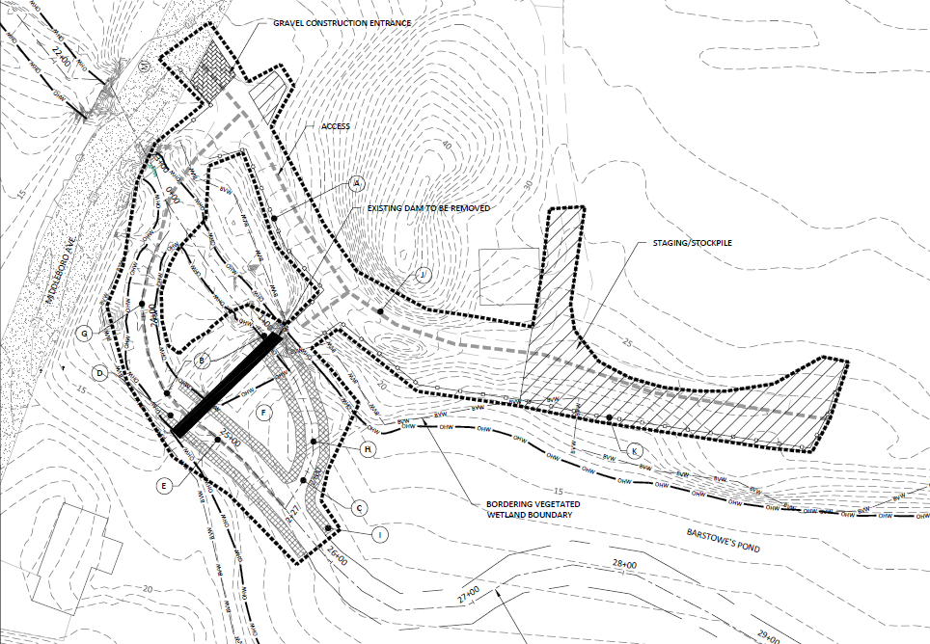

Slide 24
The Process
1. Dam owner wants to remove dam
2. Project Scoping
3. Cost / feasibility assessment
4. Engineering & Design Process
5. Fundraising
4. Permitting
Final Construction Plans and Permits
Bid Process / Contracting
Dam Removal!!!

Slide 25
Permitting
MEPA
Notice of Intent to Conservation Commission
401 Permit (DEP)
Chapter 91 Dredge Permit (DEP)
404 permit (an abbreviated form)
Project Notification Form to Massachusetts Historical Commission
Chapter 253 Dam safety permit (if Jurisdictional Dam)

Slide 26
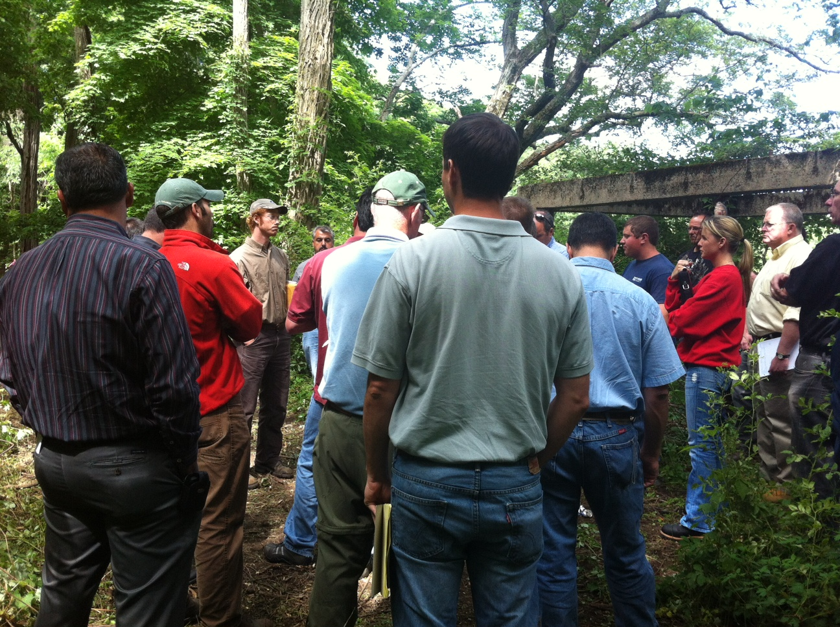
Construction bidding and contracting

Slide 27
The Process
1. Dam owner wants to remove dam
2. Project Scoping
3. Cost / feasibility assessment
4. Engineering & Design Process
5. Fundraising
4. Permitting
Final Construction Plans and Permits
Bid Process / Contracting
Dam Removal!!!

Slide 28
The Dam Removal Process and the Role of the Project Manager
Hopewell Mills Dam Removal,
Mill River, Taunton, 2012
1. The role of the project manager
2. Overview of the dam removal process
3. Discussion
Audience:
Municipal or non-profit organization staff that are planning to manage a dam removal project

Slide 29
